Slide 1



Slide 2

Basic Details of the Team and Problem Statement
Ministry/Organization Name/Student Innovation:
Ministry of AYUSH.
PS Code: 1503.
Problem Statement Title: Automatic Drug Dispenser.
Team Name: TEAM MINTMIND.
Team Leader Name: Harshit Rajpriya Shobhane.
Institute Code (AISHE):
Institute Name: Indian Institute Of Information Technology Ranchi(IIITR).
Theme Name: MedTech / BioTech / HealthTech.

Slide 3
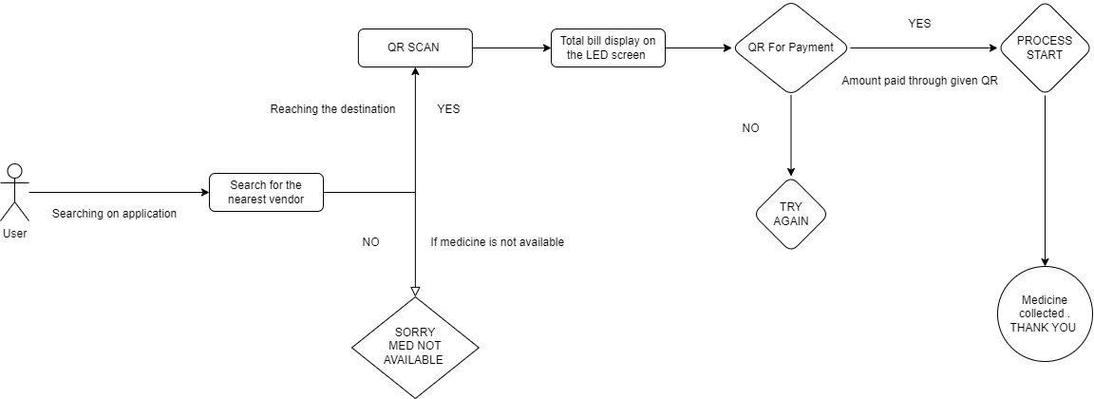







Idea/Approach Details
We hope to solve this problem by developing an IoT-based system that can read the QR code, determine what medication is needed, and dispense it in a timely and precise fashion. The Prototype will function as follow :
Utilize an ESP Cam to identify and capture the QR code.
Decode the QR code to extract medication information, including required medicines and quantities.
Calculate the cost of the identified medicines and generate an itemized bill.
Display the total cost on an LED screen for the user to view.
Provide the user with a QR code for payment.
Verify the payment using the provided QR code.
If payment is confirmed, accurately dispense the required medications.
Notify the user that the medications are ready for pickup, ensuring a secure and efficient medication dispensing process.
Technology stack:

Slide 5
Idea/Approach Details
Describe your Dependencies / Show stopper here
⮚Medication Donations: Enable users to donate unused, effective medications to those in need. Reward donors with future drug purchase discount coupons, promoting charitable giving.
⮚Expiration Alerts: Notify users in advance of medication expiration dates. Encourage timely usage or replacement to maximize effectiveness and reduce waste.
⮚Emergency First Aid Kits: Stock vending machines with basic supplies like bandages, antiseptics, and pain relievers. Enhance public safety by providing essential medical care items.
⮚ Remote Monitoring and Restocking: Connect vending machines to the internet for real-time monitoring. Offer automatic restocking recommendations when pharmaceutical supplies run low.
⮚Cashback Incentives: Reward medicine donors with redeemable cashback points.
Foster social responsibility and frequent vending machine use.
⮚Prescription Validation: Verify medication authenticity and safety using barcode scanning or image recognition. Ensure donated medicines meet quality standards.
⮚Medication Disposal: Provide an eco-friendly option for safe medication disposal. Safeguard public health and the environment.
⮚ Health Reports: Generate regular reports on medication donations, expiration alerts, and first aid distribution. Recognise user contributions to public health.
⮚Multilingual Support: Offer updates and notifications in multiple languages. Ensure inclusivity and accessibility.
Describe your Use Cases here
1. Searching for a Dispenser's Location:
First, our app makes it simple for users to locate a pharmacy near them.
Second, we use machine learning and artificial intelligence to find the nearest dispenser, figure out the best way to go there, and update you in real time.
2. Billing and scanning QR codes:
First, we use an ESP Cam to read the user-provided QR code.
The system reads the QR code, computes the cost of the patient's medications, and displays the total right away on an LED screen for patient approval.
3. Confirmation of Payment:
To ensure a safe and transparent procedure, medication is only dispensed when the user has paid for it using the QR code given.
4. Collection of Medications:
First, once payment is verified, the system activates the servo for the pharmaceutical slot that the QR code was scanned from. After that, patients can pick up their prescriptions in a simplified and timely manner.

Slide 6
GAME CHANGER ADDITION
⮚Medication Donations: Enable users to donate unused, effective medications to those in need. Reward donors with future drug purchase discount coupons, promoting charitable giving.
⮚Expiration Alerts: Notify users in advance of medication expiration dates. Encourage timely usage or replacement to maximize effectiveness and reduce waste.
⮚Emergency First Aid Kits: Stock vending machines with basic supplies like bandages, antiseptics, and pain relievers. Enhance public safety by providing essential medical care items.
⮚ Remote Monitoring and Restocking: Connect vending machines to the internet for real-time monitoring. Offer automatic restocking recommendations when pharmaceutical supplies run low.
⮚Cashback Incentives: Reward medicine donors with redeemable cashback points.
Foster social responsibility and frequent vending machine use.
⮚Prescription Validation: Verify medication authenticity and safety using barcode scanning or image recognition. Ensure donated medicines meet quality standards.
⮚Medication Disposal: Provide an eco-friendly option for safe medication disposal. Safeguard public health and the environment.
⮚ Health Reports: Generate regular reports on medication donations, expiration alerts, and first aid distribution. Recognise user contributions to public health.
⮚Multilingual Support: Offer updates and notifications in multiple languages. Ensure inclusivity and accessibility.

Slide 7
Team Member Details
Team Leader Name: Harshit shobhane
Branch (Btech/Mtech/PhD etc): Btech Stream (ECE, CSE etc): CSE Year (I,II,III,IV): II
Team Member 1 Name: Vishesh Dadhich
Branch (Btech/Mtech/PhD etc): Btech Stream (ECE, CSE etc): CSE Year (I,II,III,IV): II
Team Member 2 Name: Shivam Yadav
Branch (Btech/Mtech/PhD etc): Btech Stream (ECE, CSE etc): CSE Year (I,II,III,IV): II
Team Member 3 Name: Aditya Sinha
Branch (Btech/Mtech/PhD etc): Btech Stream (ECE, CSE etc): CSE Year (I,II,III,IV): II
Team Member 4 Name: Shakti Priya
Branch (Btech/Mtech/PhD etc): Btech Stream (ECE, CSE etc): CSE Year (I,II,III,IV): II
Team Member 5 Name: Pragati Ghosh
Branch (Btech/Mtech/PhD etc): Btech Stream (ECE, CSE etc): CSE Year (I,II,III,IV): I
Team Mentor 1 Name: Type Your Name Here
Category (Academic/Industry): Expertise (AI/ML/Blockchain etc): Domain Experience (in years):
Team Mentor 2 Name: Type Your Name Here
Category (Academic/Industry): Expertise (AI/ML/Blockchain etc): Domain Experience (in years):

